Slide 1


Spotify Classifier
8995 Capstone Project Presentation
By: Mariya
Tutorial: Wednesday 16:30

Slide 2


Premium
Mariya
Introduction
Dataset Details
Introduction
EDA Outcomes
PDA Outcomes
Deployment Plan
and Status Update
Spotify and YouTube Dataset from Kaggle
References
Goal
Have a deeper look into what kind of attributes most popular songs have
Thank you!
Gallery
Pricing
Contact Us
Play
Follow

Slide 3


Premium
Mariya
Introduction
Dataset Details
Introduction
EDA Outcomes
Dataset Details
PDA Outcomes
Deployment Plan
and Status Update
References
20,718 datapoints and 26 variables
The project focuses on the data from Spotify only (16 variables)
The dataset was last updated in February 2023
Thank you!
Gallery
Pricing
Contact Us

Slide 4
Premium
Mariya
Introduction
Dataset Details
Introduction
EDA Outcomes
Dataset Details
PDA Outcomes
Deployment Plan
and Status Update
References
Categorical Variables
Continuous Variables
Thank you!
Album_type – 3 Types
Key – 12 Keys
Artist
Track
Album
Danceability
Energy
Loudness
Speechiness
Acousticness
Instrumentalness
Liveness
Valence
Tempo
Duration_ms
Stream
Gallery
Pricing
Contact Us

Slide 5
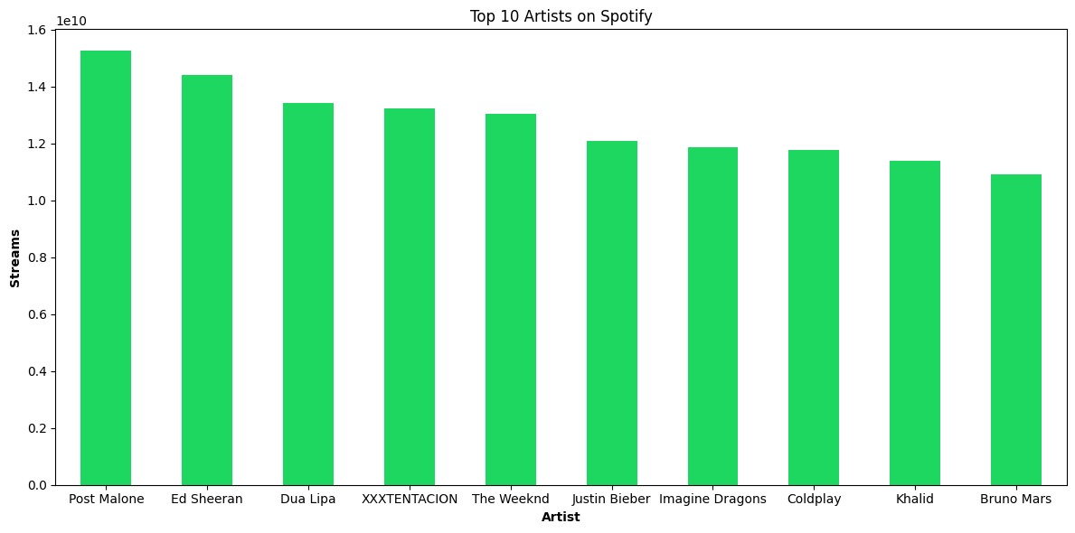
Premium
Mariya
Introduction
EDA Outcomes
Dataset Details
Top 10 Artists
EDA Outcomes
PDA Outcomes
Deployment Plan
and Status Update
References
Our Goals
Gallery
Pricing
Contact Us

Slide 6
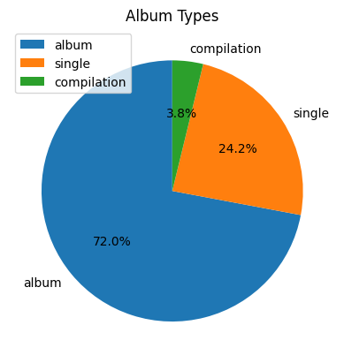
Premium
Mariya
Introduction
EDA Outcomes
Dataset Details
Album Type distribution
EDA Outcomes
PDA Outcomes
Deployment Plan
and Status Update
References
Our Goals
Gallery
Pricing
Contact Us

Slide 7
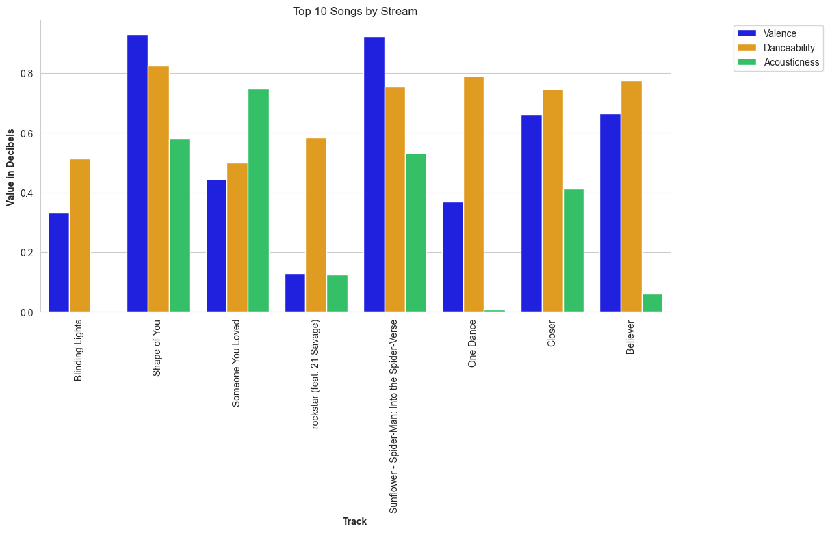
Premium
Mariya
Introduction
EDA Outcomes
Dataset Details
Top 10 Songs by number of streams
EDA Outcomes
PDA Outcomes
Deployment Plan
and Status Update
References
Our Goals
Gallery
Pricing
Contact Us

Slide 8
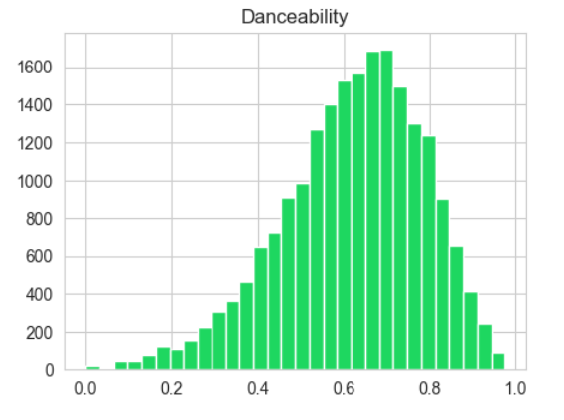
Premium
Mariya
Introduction
EDA Outcomes
Dataset Details
Number of songs vs Danceability
EDA Outcomes
PDA Outcomes
Deployment Plan
and Status Update
References
Our Goals
Gallery
Pricing
Contact Us

Slide 9
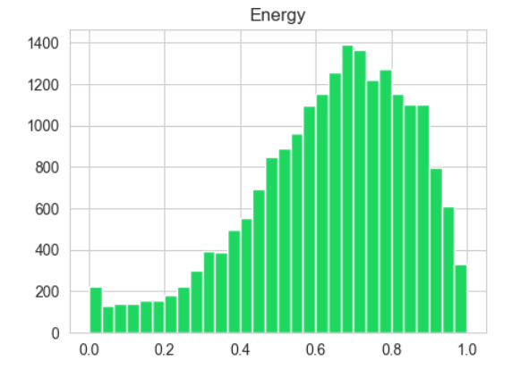
Premium
Mariya
Introduction
EDA Outcomes
Dataset Details
Number of songs vs Energy
EDA Outcomes
PDA Outcomes
Deployment Plan
and Status Update
References
Our Goals
Gallery
Pricing
Contact Us

Slide 10
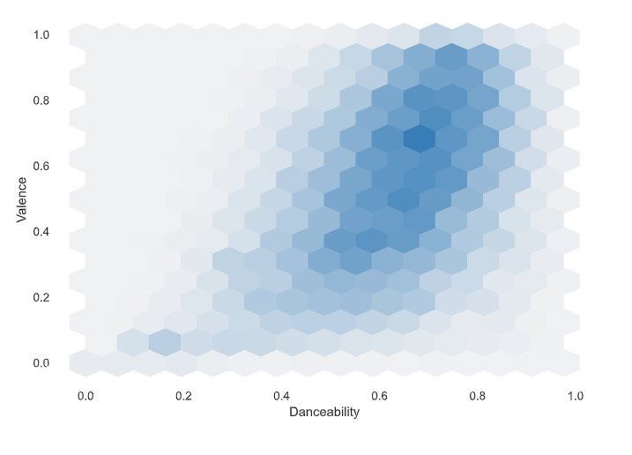
Premium
Mariya
Introduction
EDA Outcomes
Dataset Details
Valence vs Danceability
EDA Outcomes
PDA Outcomes
Deployment Plan
and Status Update
References
Our Goals
Gallery
Pricing
Contact Us

Slide 11
Premium
Mariya
Introduction
PDA Outcomes
Dataset Details
EDA Outcomes
PDA Outcomes
Predict Album Type based on a track’s attribute
Evaluate the performance of four different machine learning algorithms on the training set
Random Forest Classifier is the best model with an Accuracy Score of 0.7917471042471043. Which means, it was able to correctly predict the album types of about 79.17% of the tracks in the test dataset.
Deployment Plan
and Status Update
Model | Mean | Standard Deviation
Gaussian NB | 0.676782 | 0.007194
Support Vector Machine | 0.720707 | 0.008943
Gradient Boosting Classifier | 0.728128 | 0.009415
Random Forest Classifier | 0.773017 | 0.008295
References
Our Goals
Gallery
Pricing
Contact Us

Slide 12
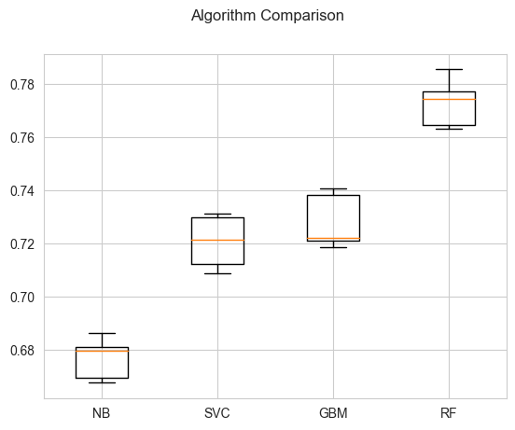
Premium
Mariya
Introduction
PDA Outcomes
Dataset Details
EDA Outcomes
PDA Outcomes
Deployment Plan
and Status Update
References
Our Goals
Gallery
Pricing
Contact Us

Slide 13
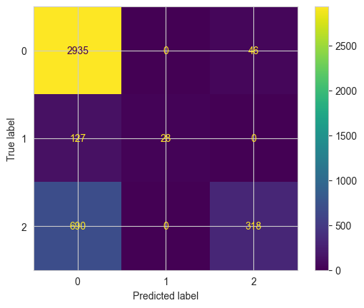
Premium
Mariya
Introduction
PDA Outcomes
Dataset Details
Confusion Matrix
EDA Outcomes
PDA Outcomes
Deployment Plan
and Status Update
References
Our Goals
Gallery
Pricing
Contact Us

Slide 14
Premium
Mariya
Introduction
Deployment Plan
and Status Update
Dataset Details
EDA Outcomes
PDA Outcomes
Deployment Plan
and Status Update
Tkinter
Work in progress
References
Our Goals
Gallery
Pricing
Contact Us

Slide 15
Premium
Mariya
Introduction
Dataset Details
EDA Outcomes
References
PDA Outcomes
Deployment Plan
and Status Update
Rastelli, S. (2023) Spotify and YouTube, Kaggle. Available at: https://www.kaggle.com/datasets/salvatorerastelli/spotify-and-youtube (Accessed: 02 May 2023).
Penguin Classifier
References
Our Goals
Gallery
Pricing
Contact Us

Slide 16
Thank You!

